Slide 1

PRESENTATION TO AVITA TECH
Avita Tech
Dec ‘21

Slide 2
Agenda
Introduction
Capabilities
Cloudflare Overview
Cloudflare One
Zero Trust Solution
Secure Web Gateway
Remote Browser Isolation
Summary
Next Steps

Slide 3








Blazeclan Overview
Revenue Growth at
80% CAGR
350+ Cloud Experts;
120 Certified
End to End Cloud
competencies
Differentiated,
Proprietary Frameworks
Focus on Innovation
Vast Experience, Across
domains/industries
200+ Customers
Engagements
Culturally Aligned-
One team

Slide 4

Blazeclan Global Footprint
Canada
USA
Europe
India
Malaysia
Singapore
Indonesia
Australia & NZ

Slide 5
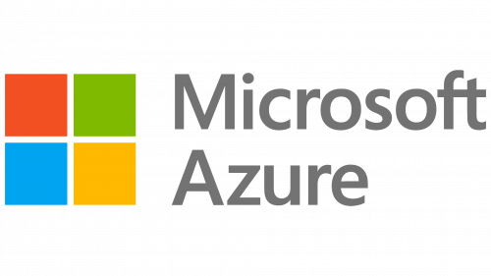

Our Partners
Gold Partner
Premier Partner

Slide 6
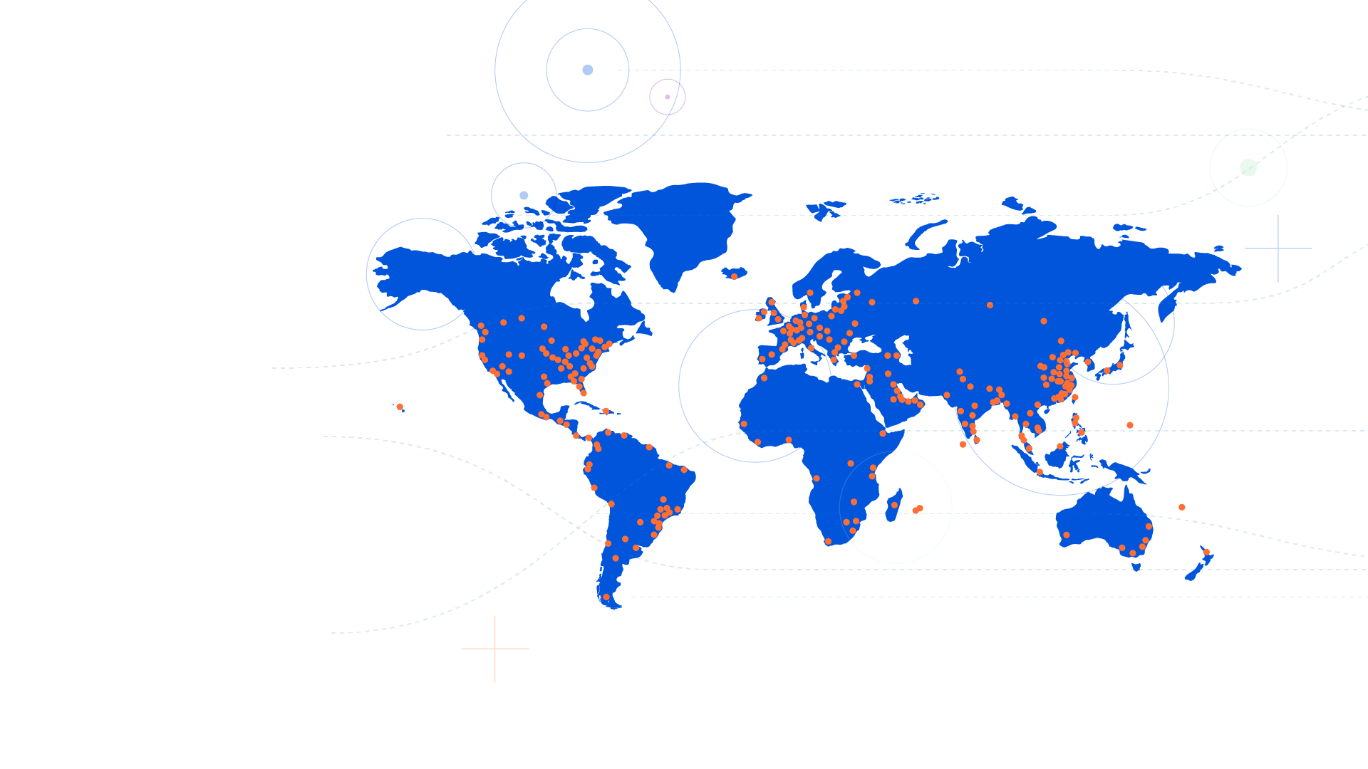

The Cloudflare global network
250+
cities in 100+ countries,
including mainland China
10,000
networks directly connect
to Cloudflare, including ISPs, cloud providers & large enterprises
121 Tbps
of network edge capacity
& growing
<50 ms
from 95% of internet users
= Cloudflare city (Map data as of September 15, 2021)
Notes:
It all starts with CFs global network. We’ve been building it for over 10 years. CF has spent hundreds of millions on the footprint to get us within 50 milliseconds of 95% of the users on the Internet. And we continue to make this one of our top priorities.
Our infrastructure is in data centers in over 250 cities around the world across 100 countries. Including mainland China
We connect directly to over 10,000 major networks including ISPs, Carriers, cloud providers, and even large enterprises. We operate our own backbone and most carriers are delighted to partner with us because we serve a significant portion of the Internet, which translates to a lot of traffic.
At the end of 2021, our overall capacity was 121 Tbps, and that’s growing everyday. We are servicing 4M+ customers with 35M websites/apps.

Slide 7
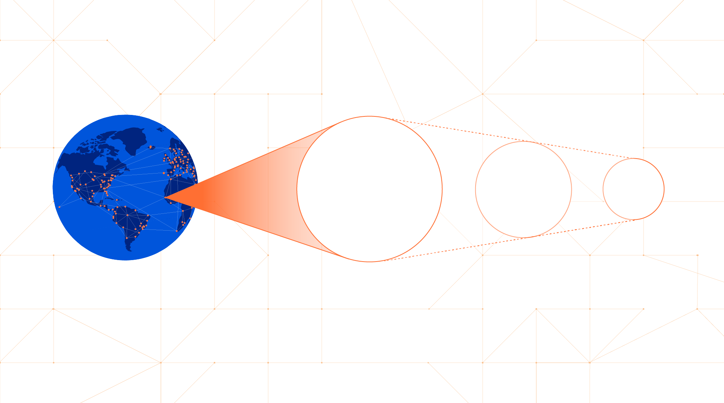


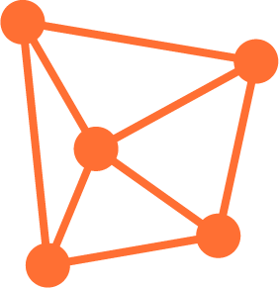
The power of every service everywhere.
Every
data-center
Every
server
Every
service
Global network
Notes:
Slide goals:
Our unique advantage
Communicate the speed, scale and reliability of our network.
Core pitch talk track [120 words, 0:45 minute]
When you use Cloudflare One, you’re putting our entire global anycast network in front of yours.
And using it to build your private network on the internet.
Our security services are standardized across our entire network, with every service running on every server, in every one of our data centers around the world. But what does it mean for you and your networking needs?
That means we can offer single-pass-inspection of requests that’s lightning fast, and consistent for users no matter where they connect from.
We have 10,000 network interconnects with ISPs, SaaS providers, and we’re highly co-located with Microsoft, Amazon, and Google.
So when users hit our edge requesting content from those providers (which account for roughly one-eighth of the internet), it’s located right next to us.
Our scale, combined with the speed and reliability of our routing, allows Cloudflare to provide customers with a 100% global uptime SLA.
Next: Cloudflare at a Glance

Slide 8




ZTNA = Zero Trust Network Access | SWG = Secure Web Gateway | CASB = Cloud Access Security Broker
Cloudflare at a Glance
Cloudflare Zero Trust Services
Cloudflare Network Services
Cloudflare Application Services
1
Cloudflare One
Zero Trust platform
WAN-as-a-Service
WAF with API Protection
ZTNA with Private Routing
Firewall-as-a-Service
Rate Limiting
Remote Browser Isolation
L3 & L4 DDoS Protection
Load Balancing
SWG with CASB
Network Interconnect
Bot Management
Identity/Endpoint Integration
Smart Routing
L7 DDoS Protection
CDN and DNS
Cloudflare Edge Developer Platform
Workers
Workers KV
Pages
Durable Objects
Video Streaming
Cloudflare Global Network
Global Edge: 250+ cities, 95% of population within 50ms, 10000 interconnects, 121 Tbps capacity, China Network
Building Blocks: SSL/TLS, mTLS, Authoritative/Recursive DNS, DNSSEC, DNS over HTTP, L4-7 over Wireguard
Compliance/Privacy: FedRAMP, ISO, SOC, PCI, GDPR compliant, Logs & Analytics, Data Localization Suite
Notes:
Slide goals:
Answer: What is Cloudflare? Aren’t you a CDN? What do you offer for SASE?
Primer to describe the company with prospects unfamiliar with us, or customers who only know us or use us for limited application services (CDN/WAF/Bots) today.
Explain that CF1 is the combination of Zero Trust and Network Services.
Core pitch talk track [90 words; 0:35 minute]
A lot of people know us for our application services but, Cloudflare is, fundamentally, a network.
We started by building a network in 250+ cities around the world.
Today that network provides one consistent architecture for all of our services with unbeatable global performance and security built-in.
Cloudflare One brings together Zero Trust security services with networking services deployed on that edge
And it’s built using our own developer platform for unrivaled cost efficiency and pace of innovation.
While other vendors are stitching together SASE platforms through a series of acquisitions or shifting virtualized applications into third-party clouds, each of our services are built from the ground up.
Before going into more details of our services, lets take a look at today’s corporate network to get an idea, how our services can help transforming it with networking and security at the forefront
More notes:

Slide 9
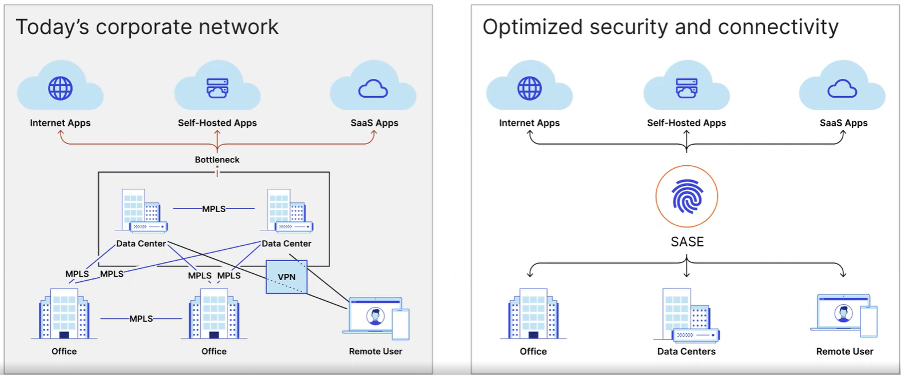
Secure Access Service Edge
Notes:
Slide goals:
Show that we understand the key problems prospects are dealing with
Introduce Secure Access Service Edge (SASE, pronounced “sass-y”) as a relevant architecture and strategy to secure and streamline their corporate network.
Preview why we believe that Cloudflare is the best provider to enable a SASE architecture
Core pitch talk track [172-182 words; 1:20 minute]
As workforces and applications exist in hybrid states along with rapid SaaS adoption, most companies we speak with are finding that their perimeter-based security approaches are breaking down.
They’re seeking more consistent and cost-effective ways to connect users, offices, and data centers to applications, with neither the complexity of backhauling through VPNs, MPLS circuits and firewalls nor the lack of visibility from split-tunneling traffic.
We know that using a Secure Access Service Edge will not convert your network from the diagram on the left to the one on right overnight. The more specific demands you have, the more years it will take.
SASE is really about securing traffic to 3 types of applications: first, the applications you don’t control, the public Internet. second, the applications you own and host your self in your data centers. And finally, the applications you rent from SaaS providers.
Whether or not you explicitly have a SASE strategy or desire simplifying your network to this degree, we believe Cloudflare has the most complete, performant, easy to use solution for enterprises to help optimize and secure some or all of your corporate network.
In the next 15 [or 20] minutes, we’ll explain Cloudflare’s offering, why it’s better than others, and our recommended approach for adopting SASE at your own pace.
Let me take you through how Cloudflare One integrates with the most critical adjacent technologies businesses use today

Slide 10


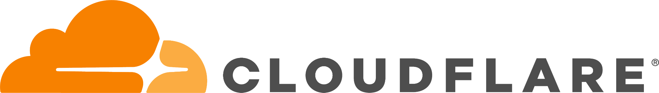



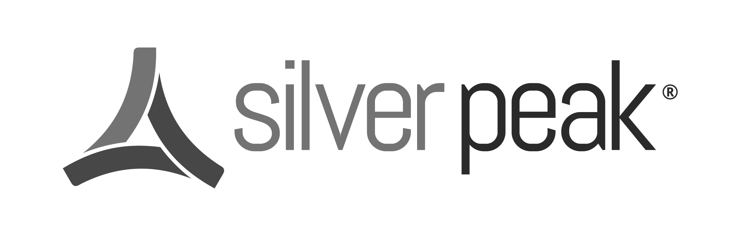

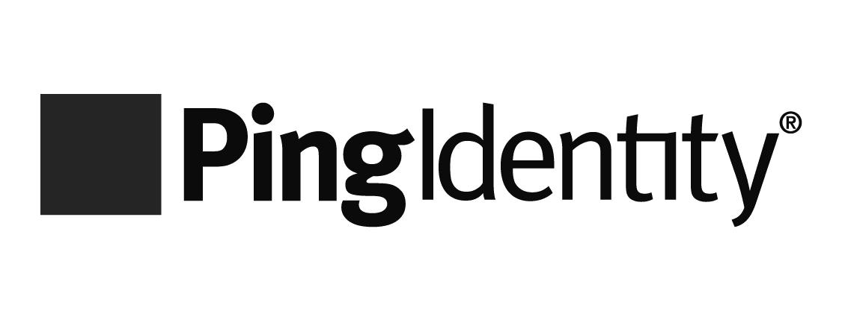

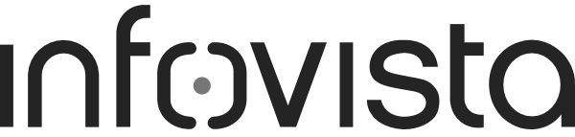
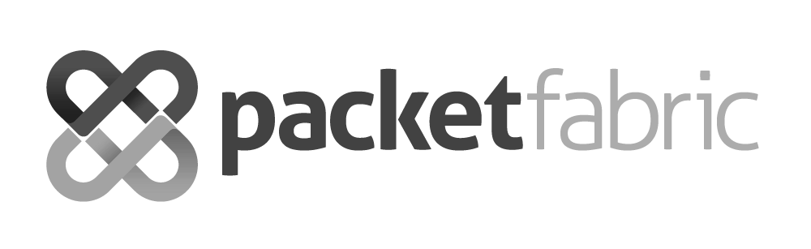
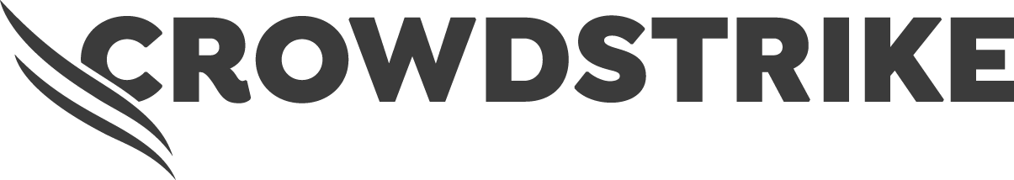

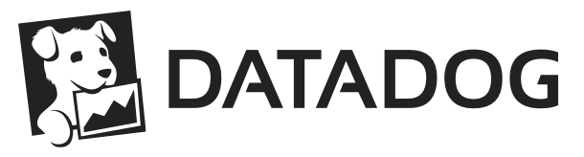
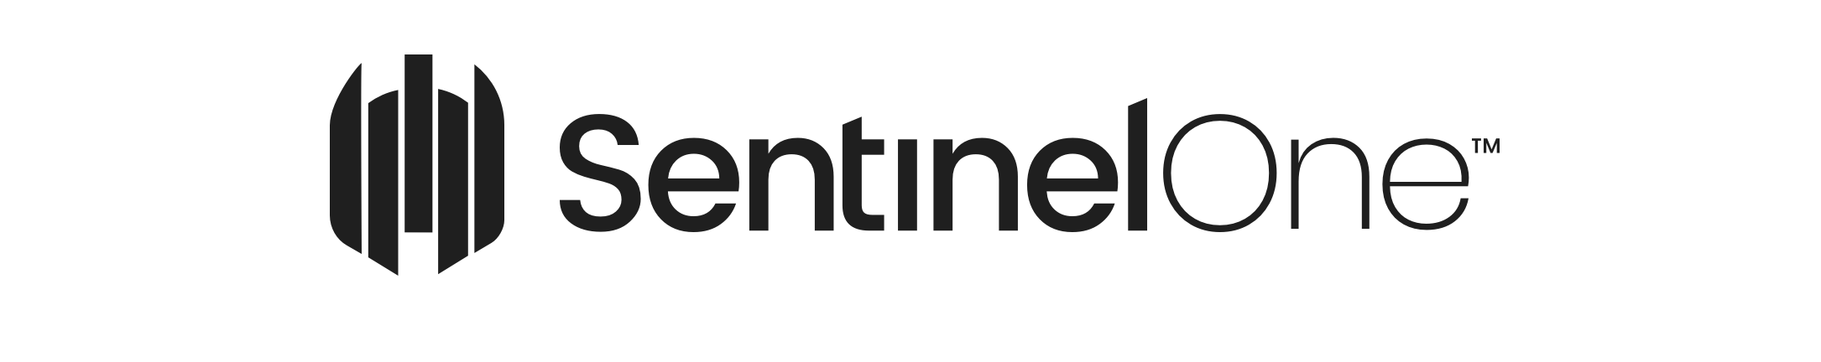
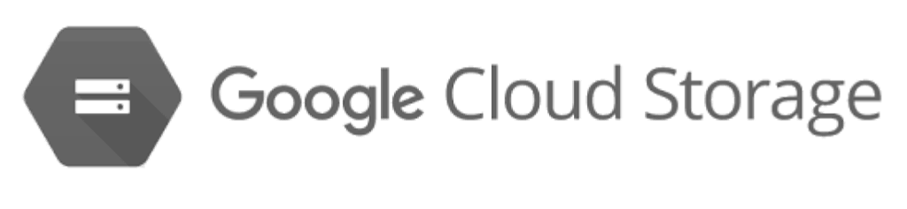



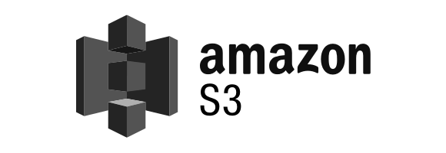



Integrates with your identity, endpoint, log, and network onramps
Cloudflare One
Network Onramp Partners
Identity and Access Management Partners
[ease of use] Concurrently use all providers to federate identity and aggregate user auth or device posture signals
[cost-efficient innovation] 1,600+ partner locations can be used to reach Cloudflare’s network
[network speed & scale] Cloud-agnostic; 50+ private interconnects built-in with Microsoft, Amazon, Google
Network interconnect
and IP transit
Identity/endpoint-agnostic
many more
Single-pass inspection
many more
Endpoint Protection & Management Partners
Single-pane management
Log Storage and SIEM Partners
device
client
Programmable interface
many more
many more via S3
Notes:
Slide goals:
Show customers how Cloudflare One integrates with the most critical adjacent technologies they use today
Talk about how having these integrations helps them with fast deployment
We are a cloud and identity-agnostic network enforcement layer.
Core pitch talk track [131 words, 0:55 minute]
We’re cloud, identity, and endpoint agnostic.
Cloudflare One integrates with the vendors you already use.
To enforce user- or role-based zero trust access controls and filters to internet, SaaS or self-hosted apps, we federate identity with up to 5 providers like Okta and Active Directory.
To get your office and data center traffic to Cloudflare, we’ve partnered with 15 leading SD-WAN and colocation connectivity providers like VMware and Equinix.
To enforce Zero Trust based on device posture context, we’ve partnered with endpoint protection providers like Crowdstrike and SentinelOne.
Finally, we can push activity logs wherever you prefer to keep them, whether it’s a SIEM solution like Splunk or a cloud storage bucket like Amazon S3.
Unlike using point solutions, set up each integration just once, and reuse it across many use cases.
That’s about how Cloudflare One integrates with most critical technologies you use adjecently today. Let me Introduce our Zero Trust security platform (called Cloudflare Zero Trust)
More notes:

Slide 11
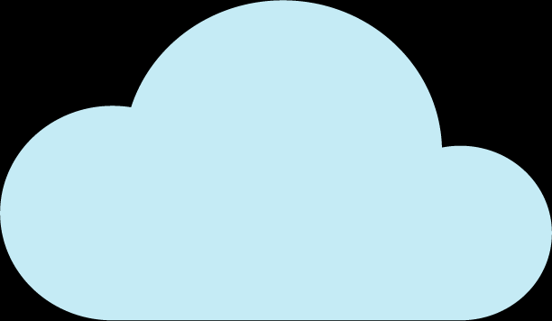


Adopt Zero Trust application access and Internet browsing
Cloudflare One
[network speed & speed]
Single-pass inspection for secure, fast, reliable, private connectivity
[ease of use] Single-pane management unifies ZTNA, VPN/FWaaS, SWG, RBI, CASB and DNS
[cost-efficient innovation] Reduced spend on IT tickets and security solutions
Zero Trust platform
Internet Apps
Internet
gateway
Browser
isolation
Self-Hosted Apps
Any User
Secure
access
SaaS Apps
Notes:
Slide goals:
Introduce Cloudflare’s Zero Trust security platform (aka Cloudflare Zero Trust)
Talk about how we help them apply a zero trust security framework to both application access (ZTNA) and Internet browsing (SWG).
Core pitch talk track [133 words; 0:50 minute]
With current work from anywhere situation users are often connecting from across geographies and networks. In this case, Cloudflare’s zero trust security proves extremely useful.
Zero Trust security means that users are no longer inherently trusted to connect to corporate resources, such as with a VPN connection.
And unknown web code is not inherently trusted to run on an end-users’ device based on coming from a known site
Our platform will eliminate complexity, increase visibility, and reduce risk for every request and login remote workers make to any resource, whether IT owns it, rents it, or if it’s out there on the Internet with no ability to control it at all.
Customers can reduce time spent on IT tickets by 80% and reduce their attack surface by 91%.
It all works together with one policy builder to be easy to use in under 30 minutes, and one architecture for a faster end-user experience.
More notes:
While other vendors have ZT NetworkAccess and SWG services, they often host them in different data centers around the world. With Cloudflare Zero Trust, all of our security and performance features happens with one single-pass inspection, so it’s incredibly fast for end users.
You can allow/block DNS and HTTP requests according to your policy rules, and keep employees from running into threats on the Internet, with a secure web gateway.
But no secure web gateway can stop every attack, so we add additional threat defenses by isolating remote users’ browsing session in a secure container in the cloud.
This protects their devices from from unknown threats, and soon, you’ll be able to implement even more browser-specific controls….granular controls to stop data loss like blocking copy/paste, print, form fill, within a site.
Finally, we enforce Zero Trust application access to corporate applications, whether you rent or own them yourselves.
Instead of “trusting” that users on the VPN, or with a specific IP address, should be able to connect to your applications, Zero Trust Application Access lets you to implement consistent, identity and context-based policies for application access.

Slide 12
Zero Trust Network Access with Private Routing
Cloudflare One: Zero Trust services
[ease of use]
Same security and experience accessing legacy non-HTTP apps as modern apps
[network speed & scale]
Built-in, industry-leading DDoS & FW protections to ensure that your resources are always available
[cost-efficient innovation]
Unify network and cloud access in minutes
Verify every login and request
User
WHAT
HOW
Resource
Multiple identity providers
Firewall protected private routing
wireguard tunnel
Cloudflare Tunnel
Self-hosted apps
Client on device
Device security posture
DDoS protected reverse proxy
Internal IPs and hostnames
Contextual factors
In-browser terminal
Clientless
HTTPS
Identity
proxy
SaaS apps
Secure Web Gateway
Firewall as a Service
WAN as a Service
Zero Trust Network Access
Browser Isolation | DDoS Protection
Notes:
Slide goals:
Cloudflare Access overview
Customers may know us for protecting HTTP or web applications they’ve already orangeclouded, use this slide to show them the added breadth of everything we do now
Core pitch talk track [135 words; 0:50 minute]
Traditionally businesses have been using VPNs to connect their users to the their applications, from self hosted applications to SaaS applications. While it worked well in the past, it has networking as well as security challenges of its own.
Connecting users to applications over a VPN, or using IP-based lists, is a slow experience for users, and frustrating to manage for administrators.
VPNs can introduce risk of lateral movement, don’t check for device posture, and often have a limited ability to integrate with your identity providers to implement identity-and-context driven rules.
That’s where CF-ZT-Network Access overcomes these challenges while making it more secure than ever.
The first step is deploying Zero Trust Network Access to reduce your reliance on a VPN and stop lateral movement by eliminating ingress points to your self-hosted apps.
Instead of routing requests to your applications via a VPN to a faraway data centers, we send users requests and logins to your applications through Cloudflare’s network, in 250 locations around the world.
Users can connect to self-hosted apps that are web- or SSH-based, plus SaaS apps, in their web browser.
And they connect to internal IPs, hostnames or self-hosted apps that are not web-based or rely on RDP and thick clients through our device client.
Once the request reaches our network, Cloudflare verifies the identity, including specific authentication methods such as a hard token, device posture, and context like the origin’s country before they’re granted access to the resource.

Slide 13
Secure Web Gateway with Zero Trust Browsing
Cloudflare One: Zero Trust services
[ease of use] Simplify Internet security and compliance
[cost-efficient innovation] Stop known and unknown threats over any port and protocol
[network speed & scale] Built on top of 1.1.1.1, the fastest public DNS resolver in the world
Identity-based policy engine
User
WHAT
HOW
Resource
Wireguard tunnel or DoH
Access control
Firewall
Client on Device
Public
Internet
Resolver
Threat protection
Anycast GRE/IPsec tunnel or DNS
Proxy
Router in Office
Any
app
Data protection
Browser
Zero Trust Network Access
Secure Web Gateway
Firewall as a Service
WAN as a Service
Browser Isolation | DDoS Protection
Notes:
Slide goals:
Cloudflare Gateway overview
Gateway and Browser Isolation are natively integrated, not point solutions
Core pitch talk track [158 words, 1:10 minute]
Adopting a Zero Trust approach to Internet browsing means that no website, or website code, is trusted to run on employee devices by default.
That requires filtering, (often) isolating, and inspecting internet-bound traffic to protect employees from malware and phishing and prevent data from leaving the enterprise.
When deployed to remote or branch users, you’ll be able to send layer 4 to 7 traffic through Cloudflare’s network, where the DNS request over any port and protocol is first resolved and filtered based on domain or IP threat intelligence.
Then, the HTTP request is decrypted and filtered based on URL categorization, application group, file type, and other criteria.
If not blocked, you can optionally isolate the web code at our edge and continue to inspect any file uploads or downloads with our AV scanner.
Both DNS and HTTP rules are identity-based, so you could isolate social media sites when visited by finance users or stop marketing from accessing Salesforce reports.
More notes:

Slide 14
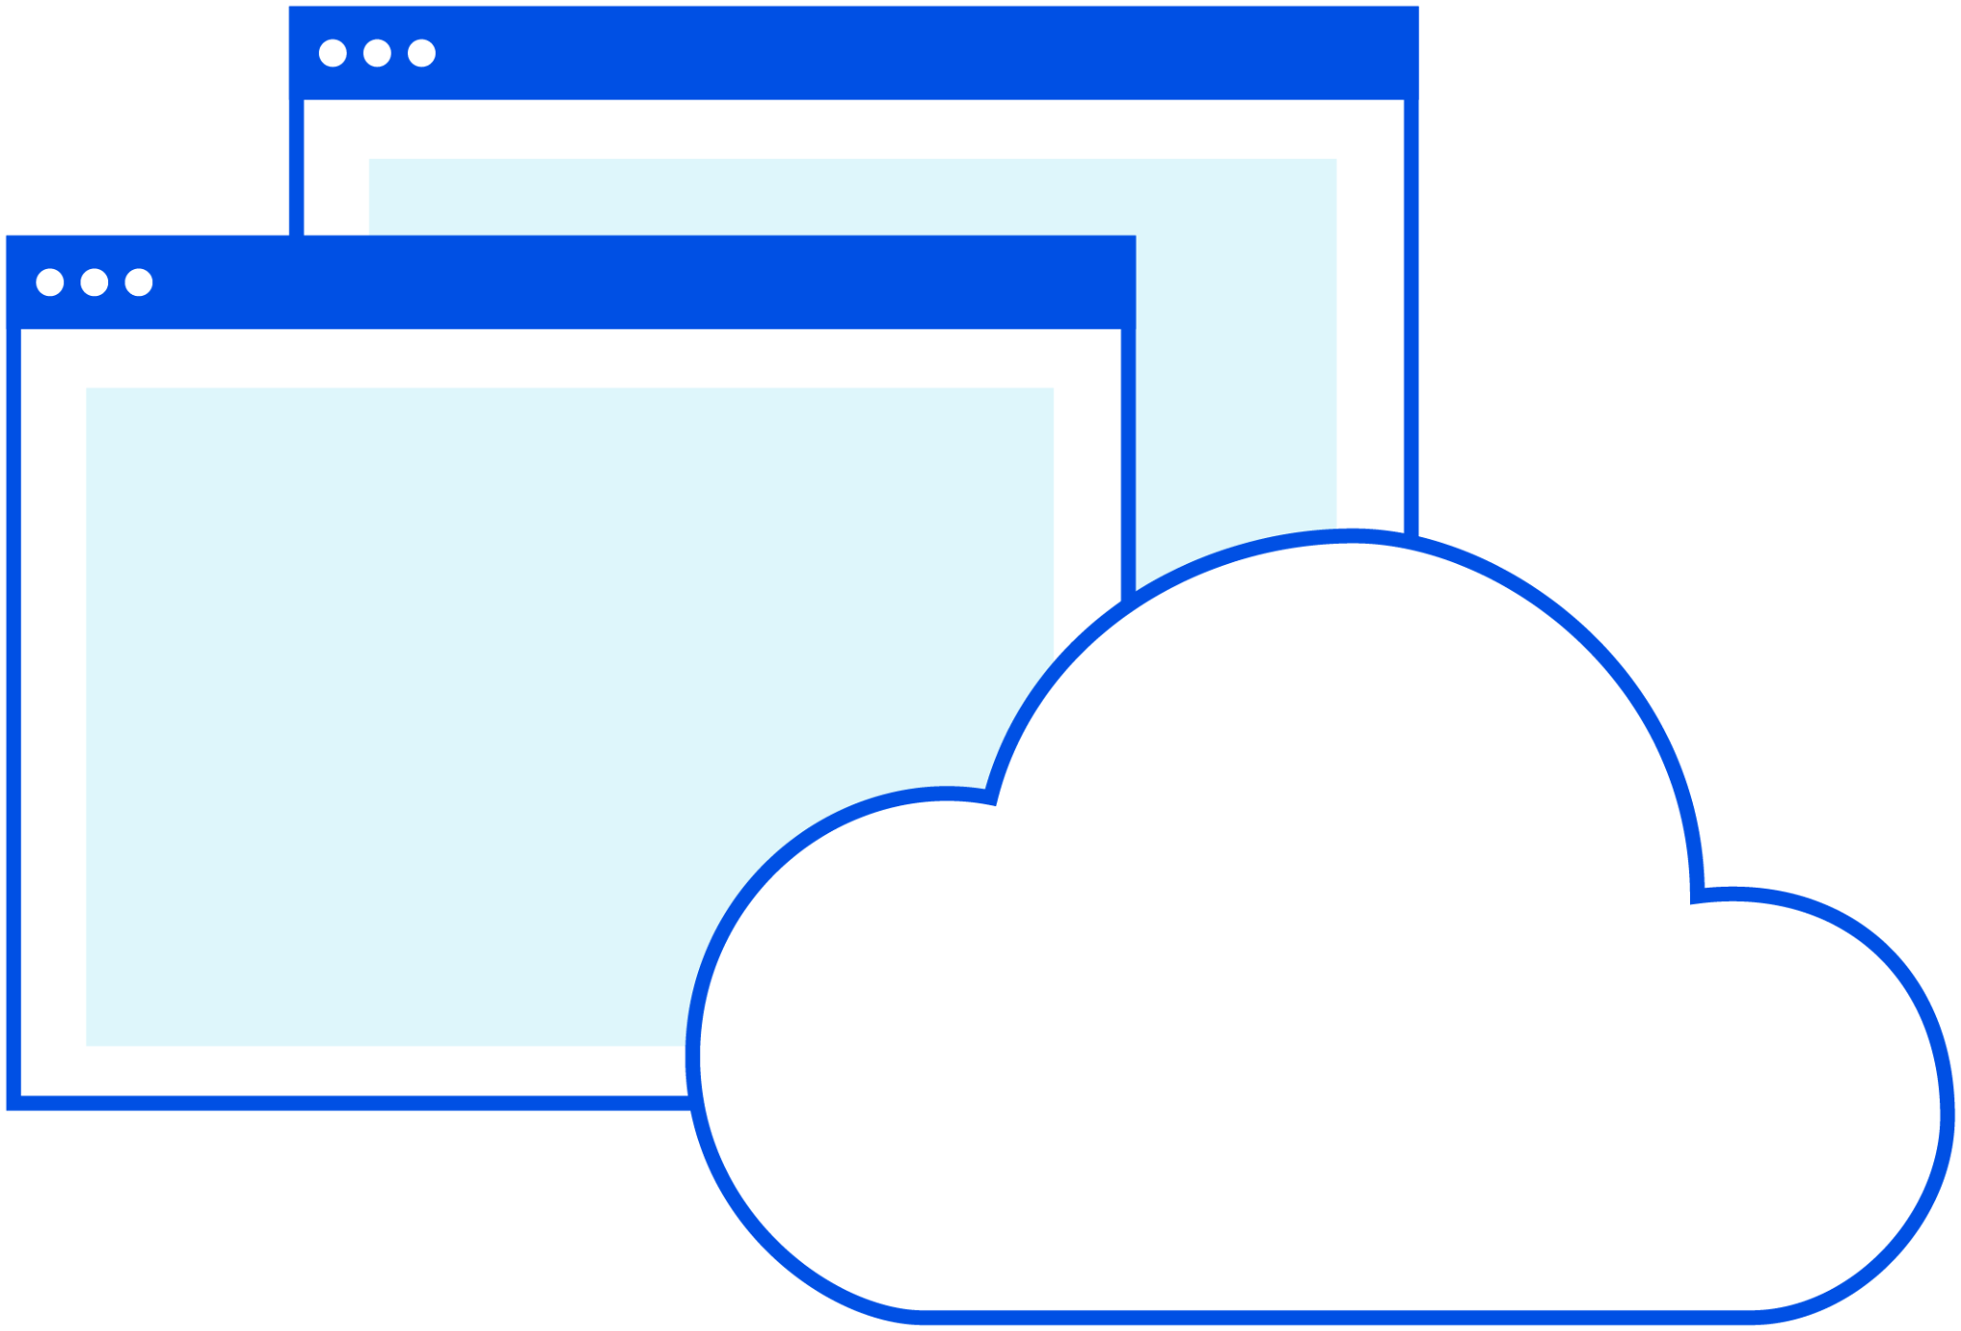
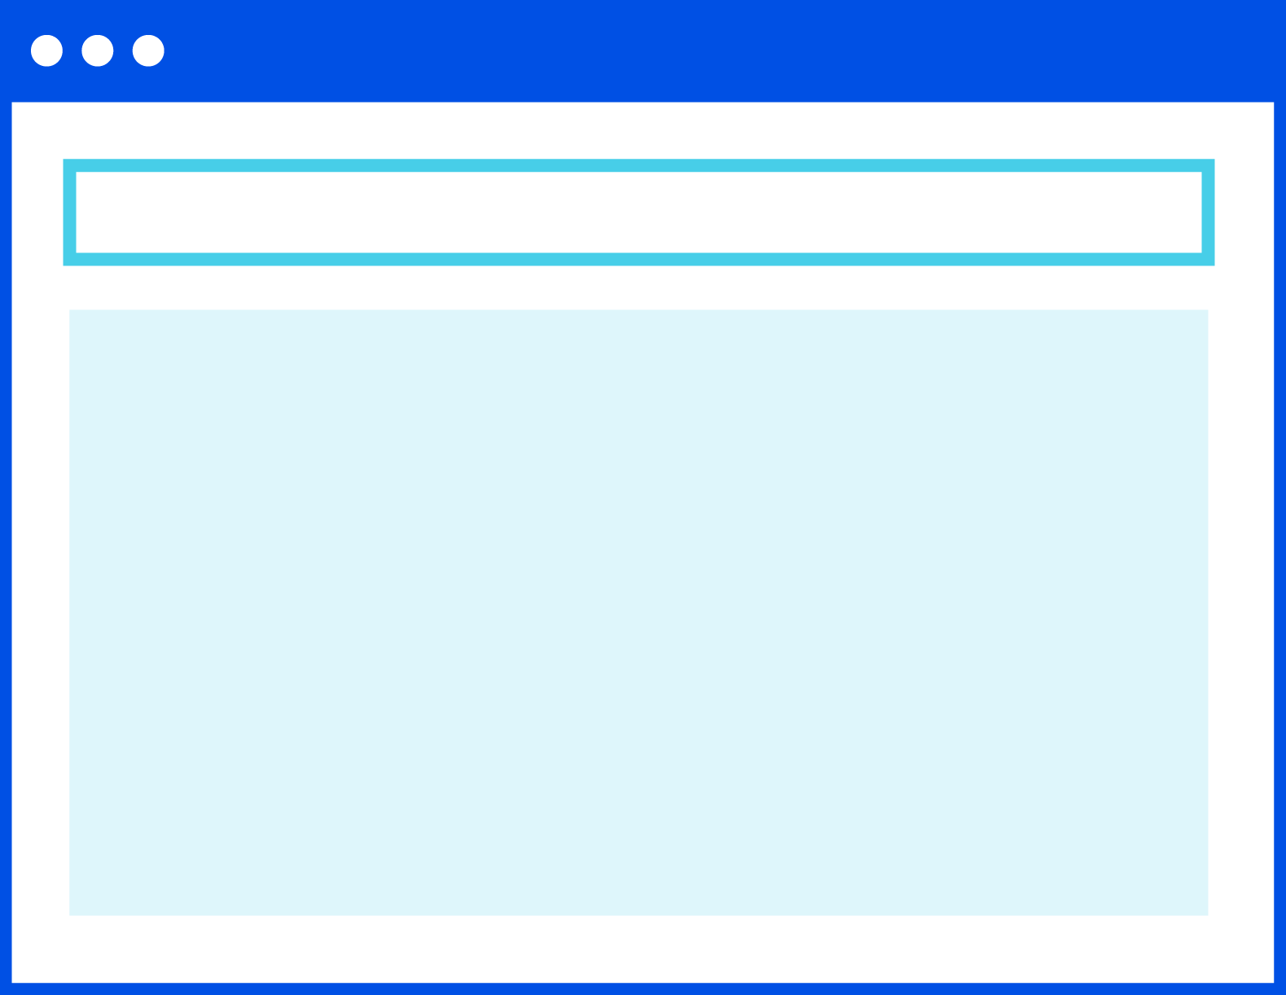
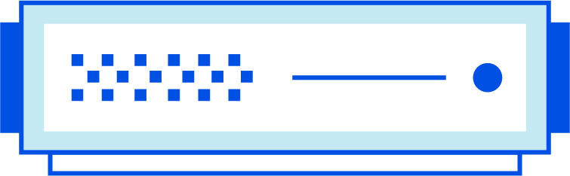
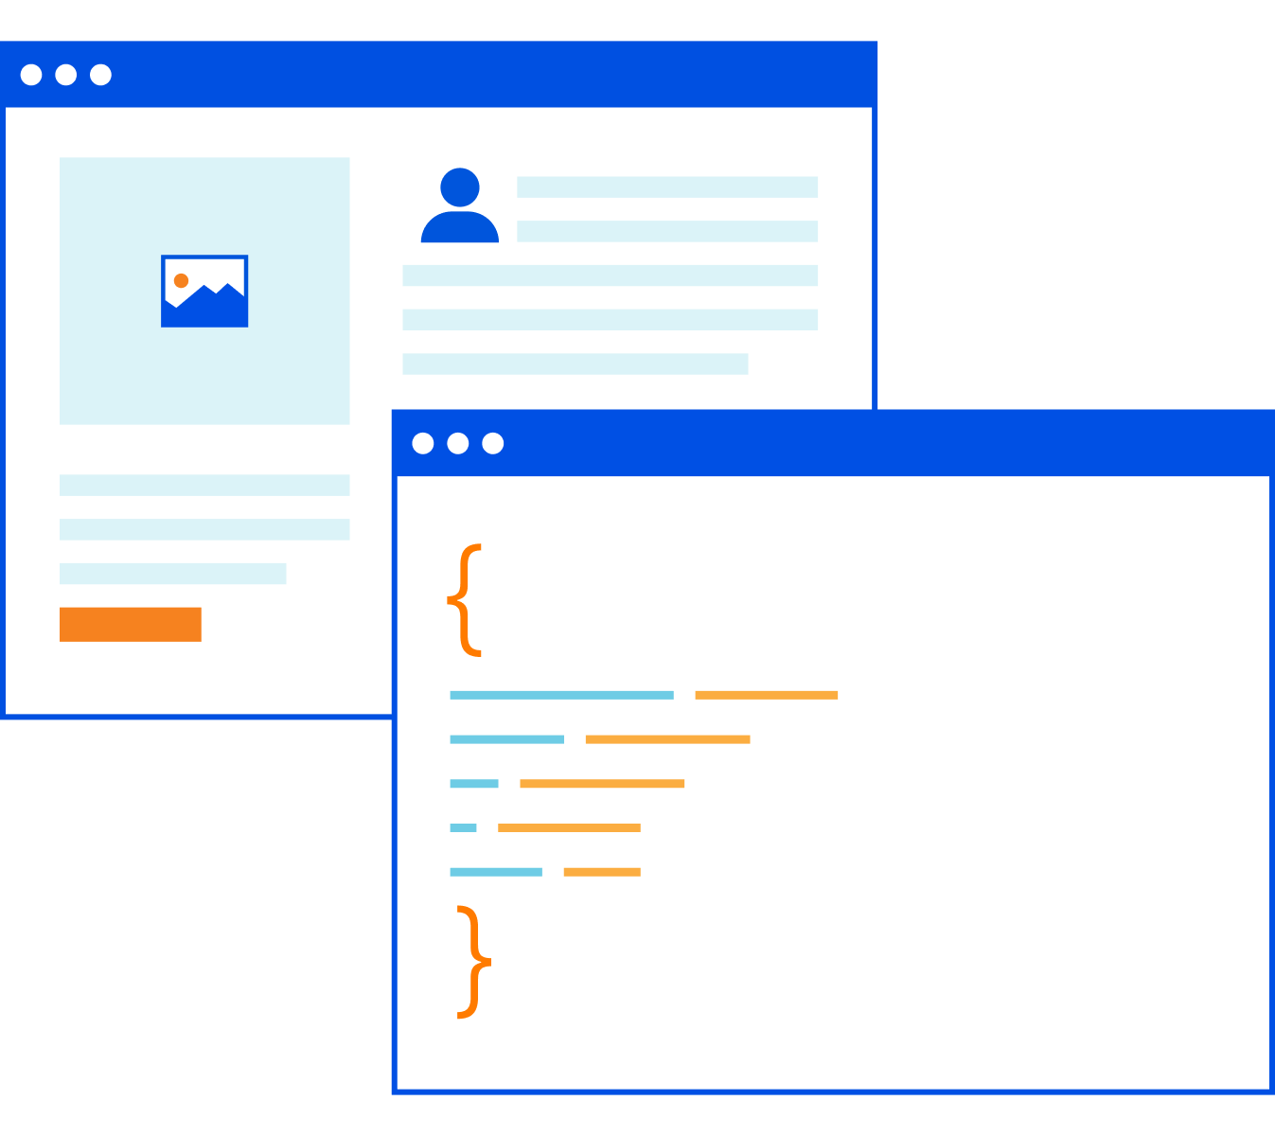
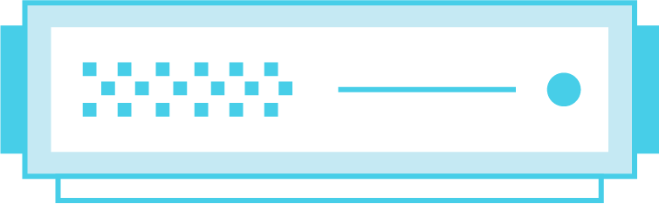
Zero Trust Browsing
Cloudflare One: Zero Trust services
[cost-efficient innovation] Perfected Internet security, fixes SWG policies that are too restrictive, or too relaxed
[ease of use] Works on any website, any browser, with a better user experience than local browsing
[network speed & scale] A global solution delivered
from a global network
Known web exploits
Zero-day web exploits
Untrusted code safely executed in
headless browser
Zero Trust draw commands
Untrusted code
User browser
Website
Zero Trust Network Access
Secure Web Gateway
Firewall as a Service
WAN as a Service
Browser Isolation | DDoS Protection
Notes:
Slide goals:
- Browser Isolation overview
- Explores how we’re better and faster
Core pitch talk track [158 words, 1 minute]
The reality is that filters and inspections will never prevent or detect 100% of threats even with the best intelligence.
And you trying to block every site that could possibly pose a risk to employees is likely to cause more damage in lost productivity..
Our Remote Browser Isolation runs a headless version of the Chromium browser at our edge, which renders all browser code, instead of your endpoints, to mitigate known and unknown threats.
It also shields application data viewed in their browser from malware-infected devices.
It’s not a standalone point solution; it’s natively built into the same policy builder and device client that you use for our gateway and access services.
Most companies have hit roadblocks attempting to deploy this technology because it’s been too slow, too expensive, and ultimately ineffective at isolating attacks.
Our approach is different from every other vendor and renders an experience that’s just as fast as local browsing without breaking any site.
More notes:
Soon, we’ll add in-browser controls to allow you to secure data in use within web browsers; starting with functions like copy/paste/print, and eventually limiting keyboard input or form fields.

Slide 15

Why Cloudflare
Network speed and scale
We have faster, intel-driven routing via more interconnects to and across our edge, which verifies, filters, isolates, and inspects traffic in one pass for a faster user experience.
Cost-efficient innovation
Replace a patchwork of proprietary circuits, network appliances, and security solutions with one solution equipped to handle the realities of cloud, mobility and digital transformation
Ease of use
Our platform was built from scratch with end user experience in mind. It deploys faster with quicker time-to-value than others’ lift-and-shift or acquire- and-stitch approaches.
Notes:
Slide goal:
Finish pitch by reminding them what we do uniquely well
More cost effective; faster global network; and better ease of use
Core pitch talk track [111 words; 0:45 minute]
Unlike other vendors, every data center across our network runs every security and performance service -- it often even delivers the requested content -- in just one pass on the same server. This network speed and scale results in an unrivaled end user experience.
We built the most cost-efficient network and compute platform with no reliance on third-parties, such that we can consolidate multiple point products to drive down your cost and complexity more than any other SASE provider.
Many SASE providers claim to have a comprehensive solution, yet their lift-and-shift or acquire-and-stitch architectures are not seamless. Cloudflare is seamless so it is faster to deploy and easier to use than any other solution.
More notes:

Slide 16
Summary
Cloudflare Overview
Cloudflare One
Zero Trust Solution
Secure Web Gateway
Remote Browser Isolation

Slide 17
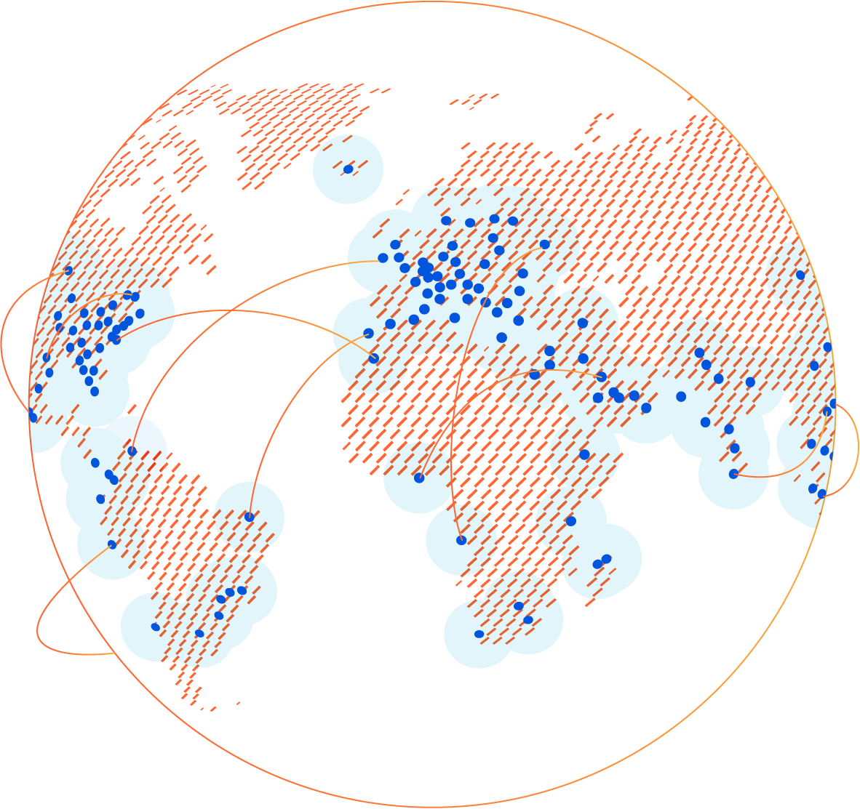
Let’s get started
Cloudflare One
Ready to transform your network with Cloudflare One?
Start a proof of concept with your account team today.
Notes:
Slide goal:
Close the presentation
Ask if they’re ready to set up a demo, proof of concept, or architecture workshop/discussion
Core pitch talk track [59 words; 0:25 minute]
Cloudflare is democratizing SASE to be simple for any size business to adopt, which is why we offer many of these capabilities in our Free Plan.
And we’d love to start you on a proof of concept with all enterprise capabilities enabled, and helping you get started with use cases that don’t require any changes to your existing environment.
More notes:

Slide 18

Thank you

Slide 20
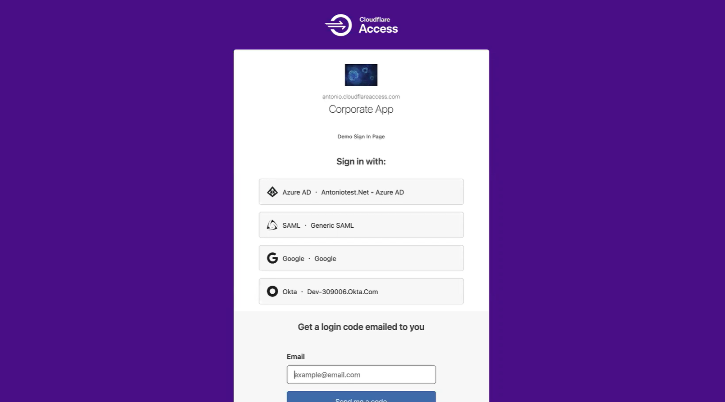

Slide 21
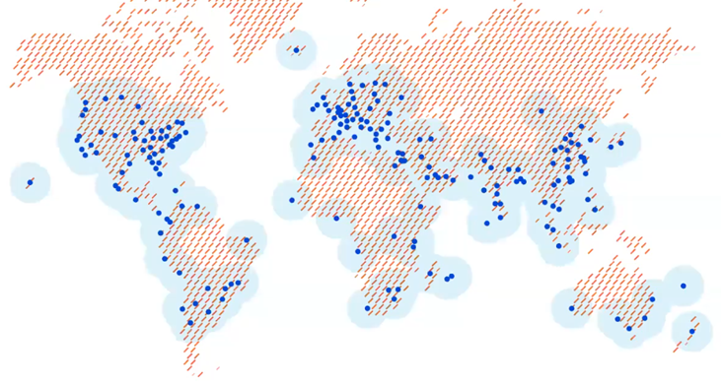
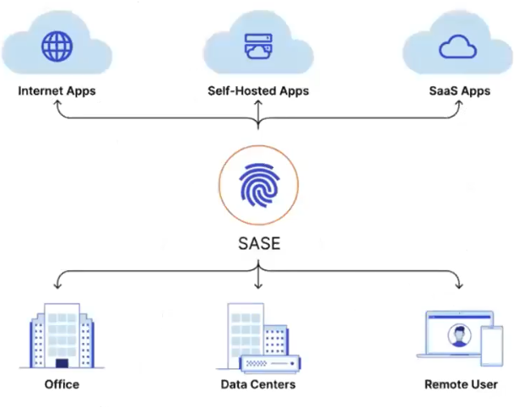


Summary
Challenges
Capabilities and Tools
Business Value
Performance
Security
Cost Efficiency
Ease
SASE

